Slide 1
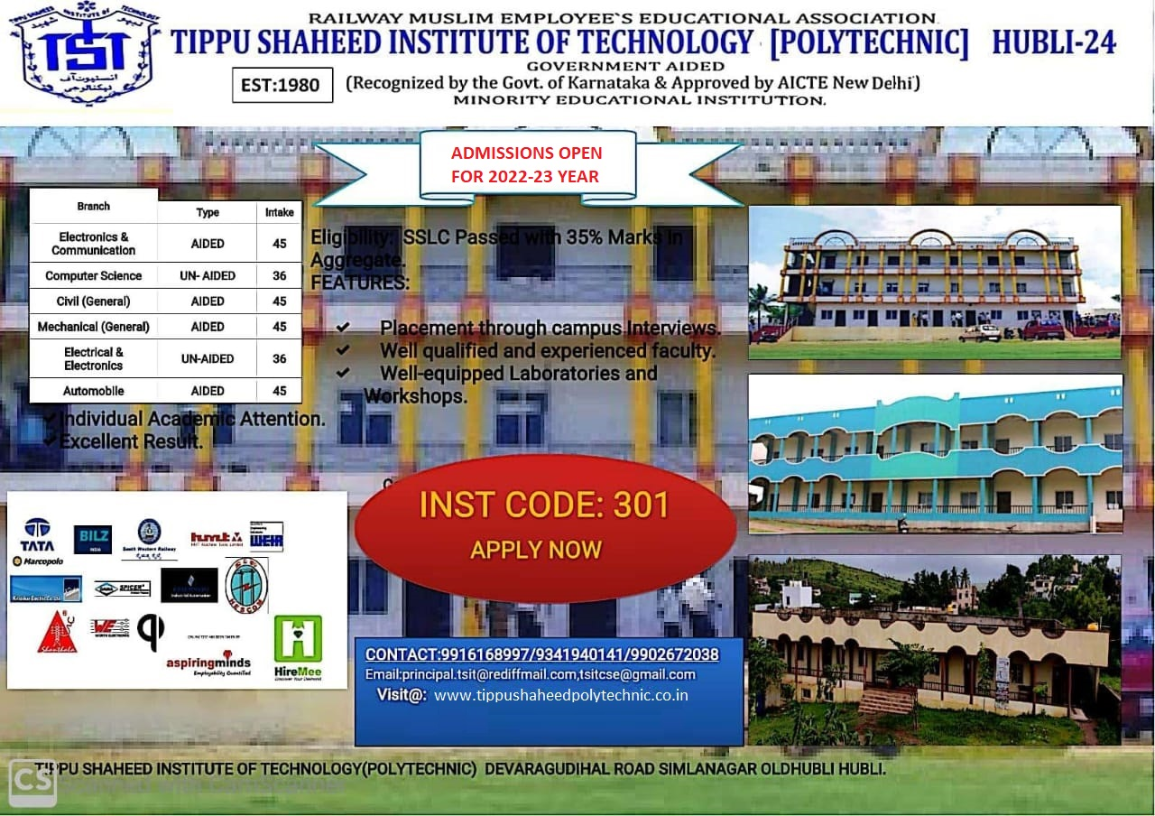
DEPARTMENT OF COMPUTER SCIENCE
TOPIC NAME: Define matrices and measurment and evaluate the values at operational level
NAME OF CANDIDATE: Moin
REGISTER NUMBER: 301CS20012
UNDER THE GUIDANCE OF:
AKSHAY SIR

Slide 2
Software Measurment & Matrices
Measurement
it deals with measuring the size, quantity, amount, or dimension of a
particular attribute of a product or process.
Ex. No of errors
members
Software project
output
product
Matrices
it provides the function by which we can measure the attribute of software
system, product or process.
Ex. No of errors per hours
Needs of Software Measurement & matrices
To ensure that the Software is bug free before release
To anticipate future qualities of process or product
To enhance the quality of a product or process

Slide 3
Types of Matrices’s
members
Software project
output
product
[Product Matrices] Describes the characteristics of the product generally includes the measurement of— size (KLOC) complexity design features quality level reliability functionality | [Process Matrices] Used to improve the development process & maintenance activities of software. Generally includes the measurement of— efforts required time to produce the product No. of defect formed tools & technology quality & efficiency | [Project Matrices] Describes project characteristics & execution Generally measure— No. of software developers cost schedule productivity quality assesses status of ongoing projects

Slide 4
Credential Management System (CMS)
Credential Management, also referred to as a Credential Management System (CMS)
is an established form of software that is used for issuing and managing credentials as part of public key infrastructure (PKI).
CMS software is used by governments and enterprises issuing strong two-factor authentication (2FA) to employees and citizens.
The CMS integrates with the components of PKI to provide one joined-up solution for IT departments to issue and manage credentials to a wide selection of devices
including smart cards, USB keys, smart phones, laptops and desktop computers.

Slide 5
Integration
Integration as process involves combining the common elements:
Security
Step 1: Do a Security Checkup. ...
Step 2: Update your software. ...
Step 3: Use unique, strong passwords. ...
Step 4: Remove apps & browser extensions you don't need. ...
Step 5: Protect against suspicious messages & content.
Usability
Usability is a quality attribute that assesses how easy interface are to use. The word “usability” also refers to methods for improving ease-of-use during the design process

Slide 6
Workflow and alerts
Clearly defined workflows. There are often hundreds of workflows in each team & department. Regular monitoring and optimization
Reporting
A maintenance report, which helps to ensure that all security equipment is
always in working condition
Reliability
It means that how much we can dependent on the CMS
(Credential Management System ) to store and revoke the password or OTP…

